Slide 1
AI 620 EMERGING TOPICS IN ARTIFICIAL INTELLIGENCE
Module 9
Sales Forecasting with Deep Learning and Autoregression

Slide 2
Learning outcomes
Understanding traditional time series forecasting
Understanding how the DeepAR model works
Understanding model sales through DeepAR
Predicting and evaluating sales

Slide 3
Auto-regressive integrated moving average (ARIMA)
ARIMA is a time series analytical technique used to capture different temporal structures in univariate data.
To model the time series data, differencing is applied across the series to make the data stationary. Differencing is the technique of subtracting the previous data point from the current one for every data point excluding the first one.
The technique makes the mean and variance of the probability distribution of the time series constant over time, making future values of the series much more predictable.

Slide 4
ARIMA underlying components
The number of autoregressive terms: These establish a relationship between a specific number of historical data points and the current one that is, it uses historical demand to estimate the current demand.
The number of non-seasonal differences: These make temporal or time series data stationary by differencing. We're assuming that future demand will look like historical demand if the difference in demand during the last few time steps is very small.
The number of moving-average terms (lagged forecast errors): These account for forecast error—actual versus forecasted demand—or a specific number of historical data points.

Slide 5
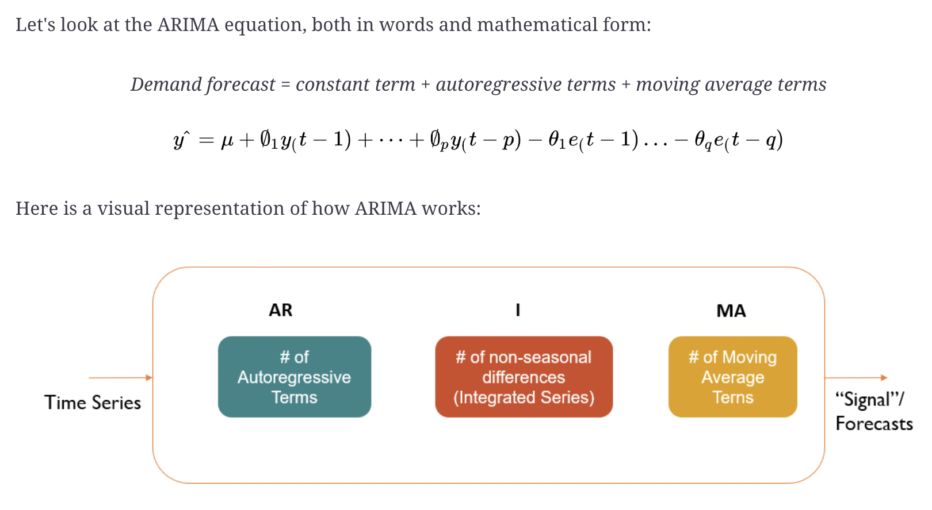
ARIMA equation

Slide 6
Exponential smoothing
The other alternative to ARIMA is the exponential smoothing technique, which is also a time series forecasting method for univariate data, where random noise is neglected, revealing the underlying time structure.
Although it is like ARIMA in that demand forecast is a weighted sum of past observations, the method of applying weights to lagged observations is different—instead of providing equal weights to past observations, the model employs exponentially decreasing weights for lags.
In other words, the most recent observations are more relevant than historical ones. Exponential smoothing is used to make short-term forecasts, where we assume that future patterns and trends will look like current patterns and trends.

Slide 7
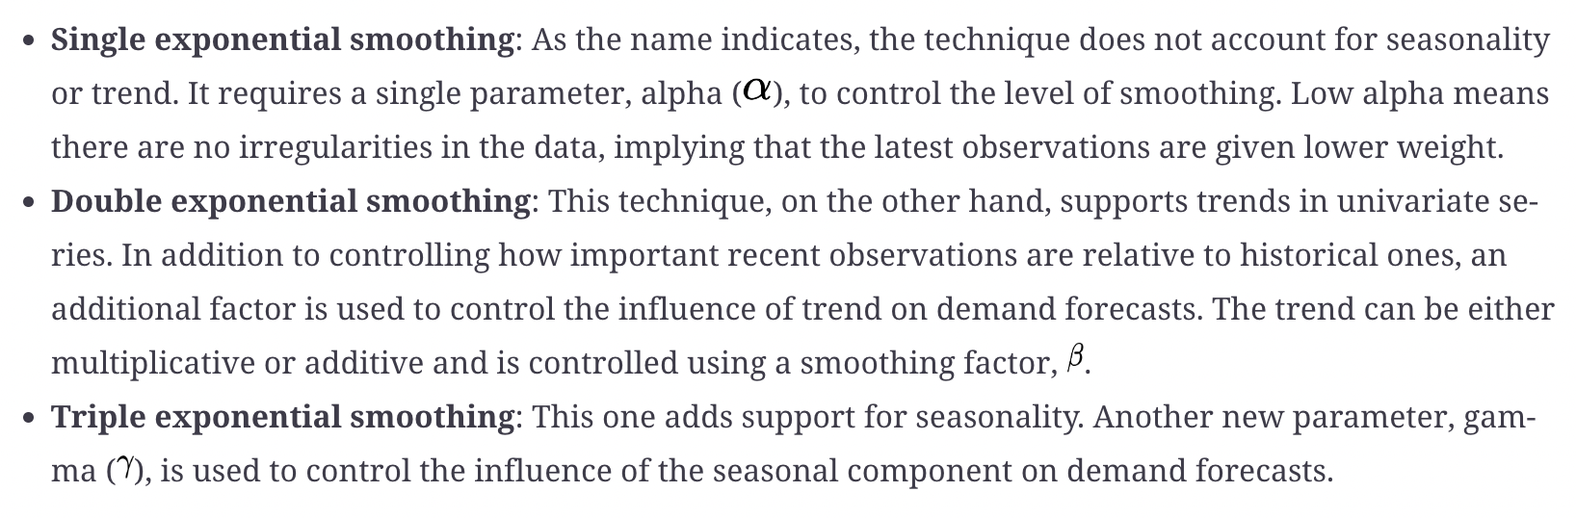
Types of exponential smoothing

Slide 8
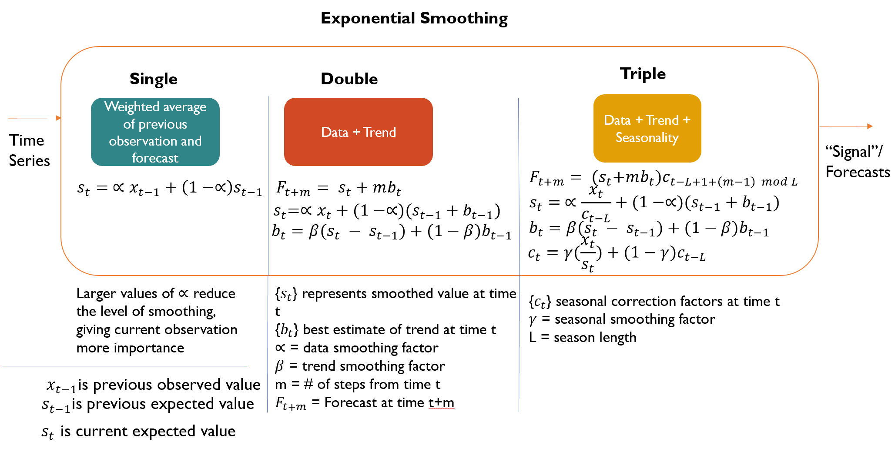
Difference between different types

Slide 9
Deepar model
The DeepAR algorithm offered by Sagemaker is a generalized deep learning model that learns about demand across several related time series. Unlike traditional forecasting methods, in which an individual time series is modeled, DeepAR models thousands or millions of related time series.
DeepAR is a forecasting method based on autoregressive neural networks and it learns about a global model from historical data of all-time series in the data set. DeepAR employs Long Short-Term Memory (LSTM), a type of Recurrent Neural Network (RNN), to model time series.

Slide 10
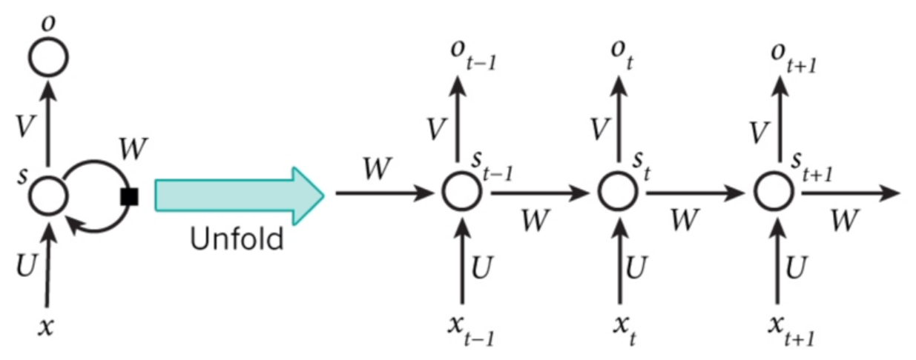
Unfolded RNN

Slide 11
UNFOLDED RNN
is input at a time, t.
is the hidden state at time, t. This state is computed based on previous hidden state and current input, and in , function, f, is an activation function.
is output at time, t, and . The activation function, f, can vary depending on the use case. For example, the softmax activation function is used when we need to predict which of the classes the input belongs to—in other words, whether the image being detected is a cat or a dog or a giraffe.
The network weights, U, V, and W, remain the same across all of the time steps.

Slide 12
LSTM
General RNNs fail to learn long-term dependencies due to the gap between recent and older data. LSTMs, on the other hand, can solve this challenge: the inner cells of LSTMs can carry information unchanged through special structures called gates—input, forget, and output. Through these cells, LSTMs can control the information to be retained or erased.

Slide 13
Model architecture
The DeepAR algorithm employs the LSTM network and probability models to identify non-linear structures in time series data and provide probabilistic estimates of forecasts.
The model is autoregressive in that it consumes observations from the last time step as input. It is also recurrent since it uses the previous output of the network as input at the next time step. During the training phase, the hidden or the encoded state of the network, at each time step, is computed based on current covariates, previous observation, and previous network output. The hidden state is then used to compute parameters for a probability model that characterizes the behavior of time series (product demand, for example).

Slide 14
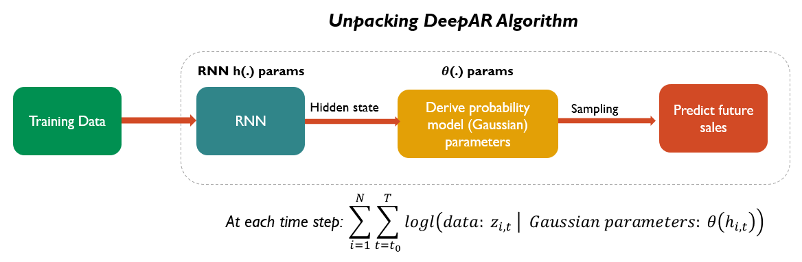
Deepar algorithm

Slide 15
Arriving at optimal network weights
The time series or observations are fed to DeepAR as part of the training. At each time step, current covariates, previous observations, and previous network output are used. The model uses Back Propagation Through Time (BPTT) to compute gradient descent after each iteration. In particular, the Adam optimizer is used to conduct BPTT. Through the stochastic gradient descent algorithm, Adam, we arrive at optimal network weights via back propagation.

Slide 16
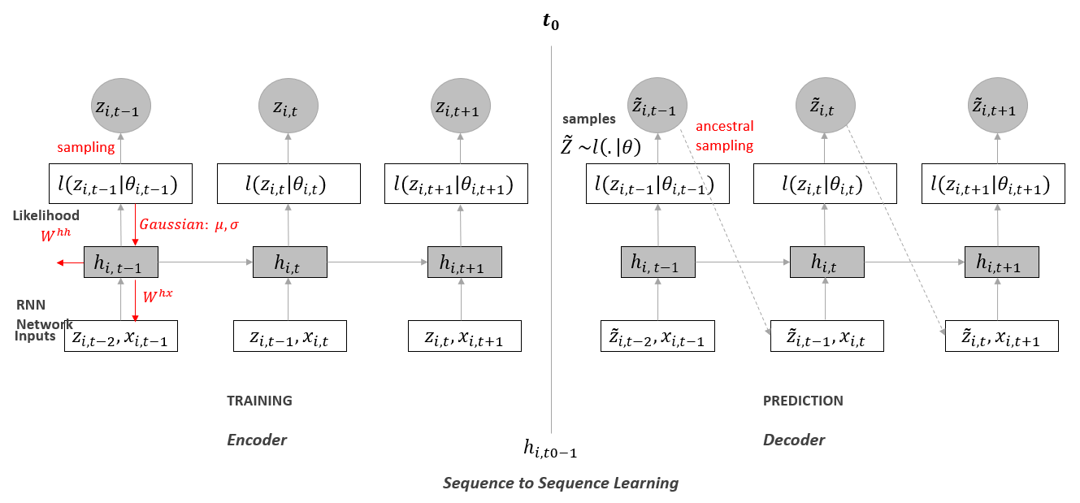
Sequence to sequence learning

Slide 17
DEEPar hyperparameters
Time frequency: Indicates whether the time series is hourly, weekly, monthly, or yearly.
Context length: How many time steps in the past the algorithm should look at for training.
Prediction length: The number of data points to predict.
Number of cells: The number of neurons to use in each of the hidden layers.
Number of layers: The number of hidden layers.
Likelihood function: We will choose the Gaussian model since weekly sales are real values.
epochs: The maximum number of passes over the training data.
Mini batch size: The size of the mini-batches used during training.
Learning rate: The pace at which the loss is optimized.
Dropout rate: For each epoch, the percentage of hidden neurons that are not updated.
Early stopping patience: The training stops after a designated number of unsuccessful epochs, those in which the loss doesn't improve.
Inference: For a given department, we sent 134 weeks of historical sales, along with the department category and holiday flag across all of the weeks.

Slide 18
Model sales through deepar
PE09-1 Data
Understand the Data
Go through textbook from page 354 to 360
Preprocess the data
PE09-2 Train DeepAR
Go through textbook from page 363 to 365
PE09-3 Predict and evaluate sales
DONE!

Slide 19
References
Tripuraneni, S., & Song, C. (2019). Hands-On Artificial Intelligence on Amazon Web Services. Packt Publishing. https://learning.oreilly.com/library/view/hands-on-artificial-intelligence/9781789534146/

